Slide 1
Project Management
Project Time Management
Project Time Management
Paul Vesey
Limerick Institute of Technology
paul.vesey@lit.ie
Autumn 2019

Slide 2
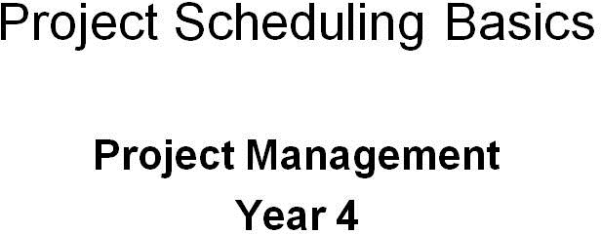
Project Management
Project Scheduling Basics

Slide 3
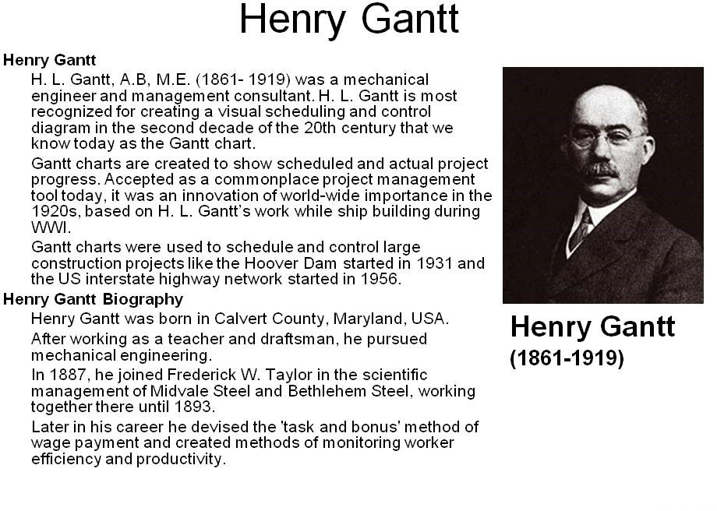
Project Management
Project Scheduling Basics

Slide 4
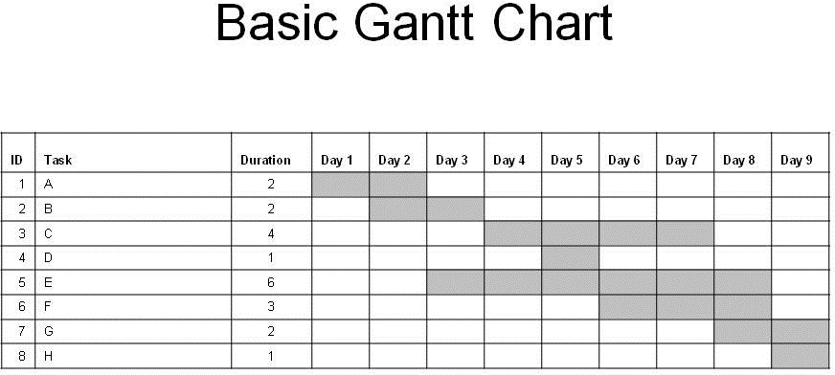
Project Management
Project Scheduling Basics

Slide 5
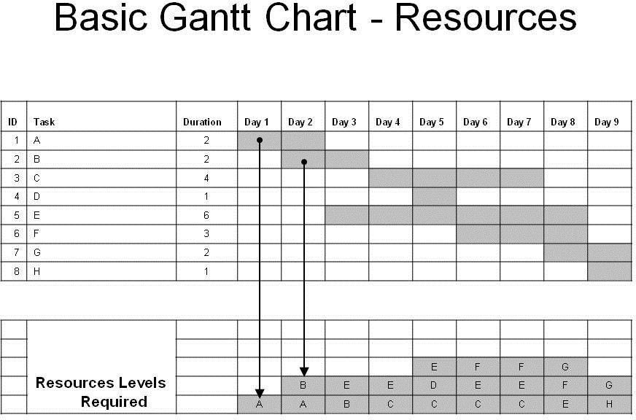
Project Management
Project Scheduling Basics

Slide 6
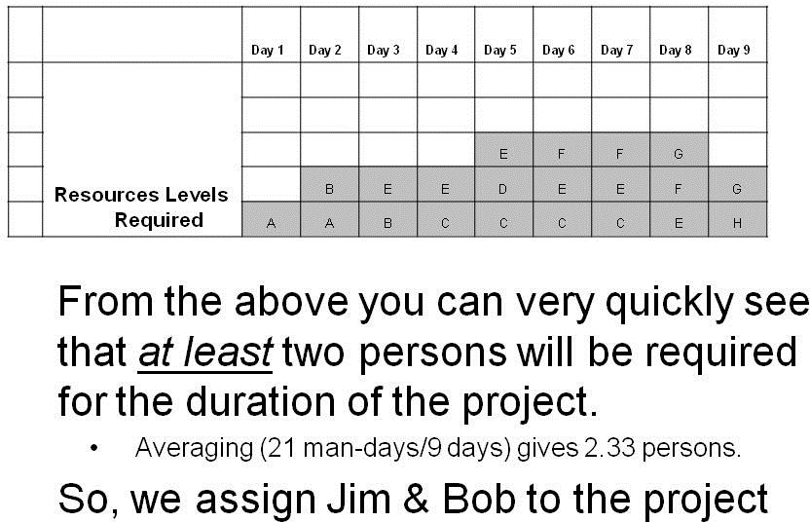
Project Management
Project Scheduling Basics

Slide 7
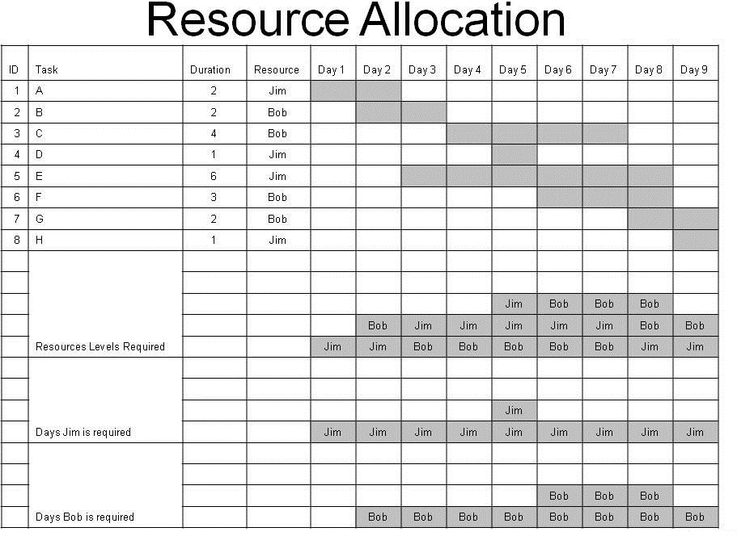
Project Management
Project Scheduling Basics

Slide 8
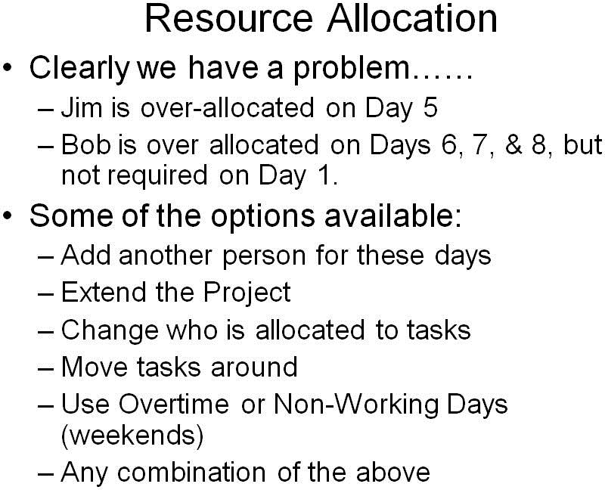
Project Management
Project Scheduling Basics

Slide 9
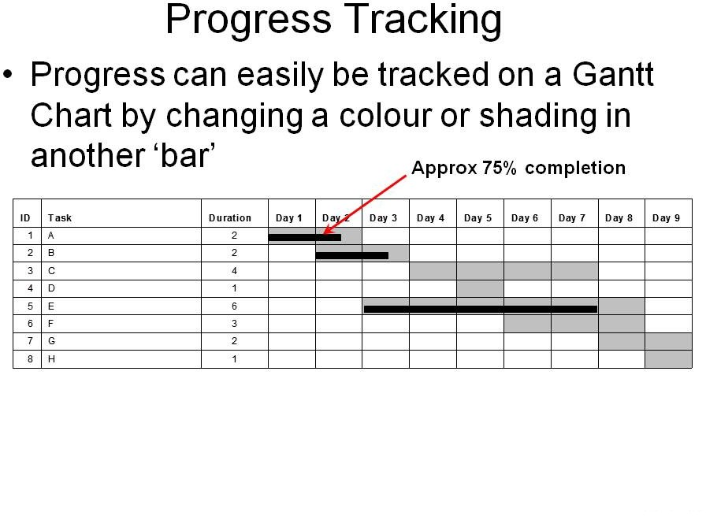
Project Management
Project Scheduling Basics

Slide 10
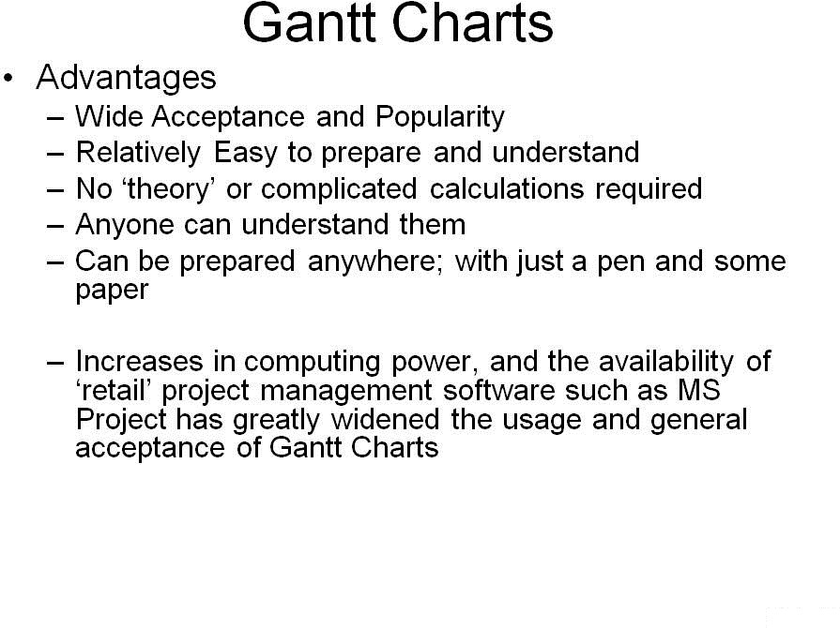
Project Management
Project Scheduling Basics

Slide 11
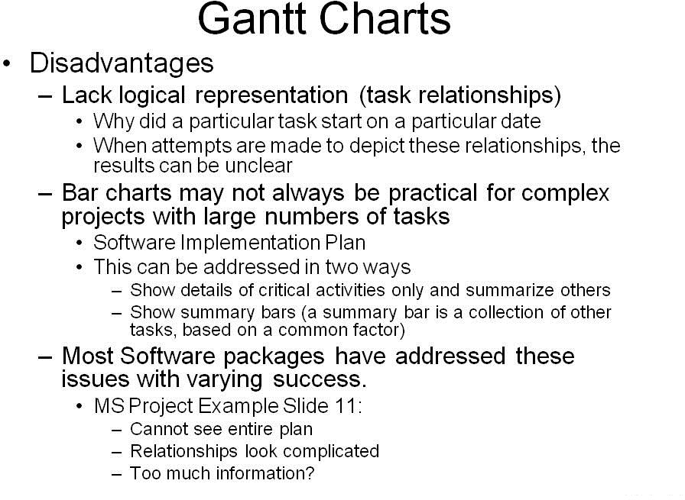
Project Management
Project Scheduling Basics

Slide 12
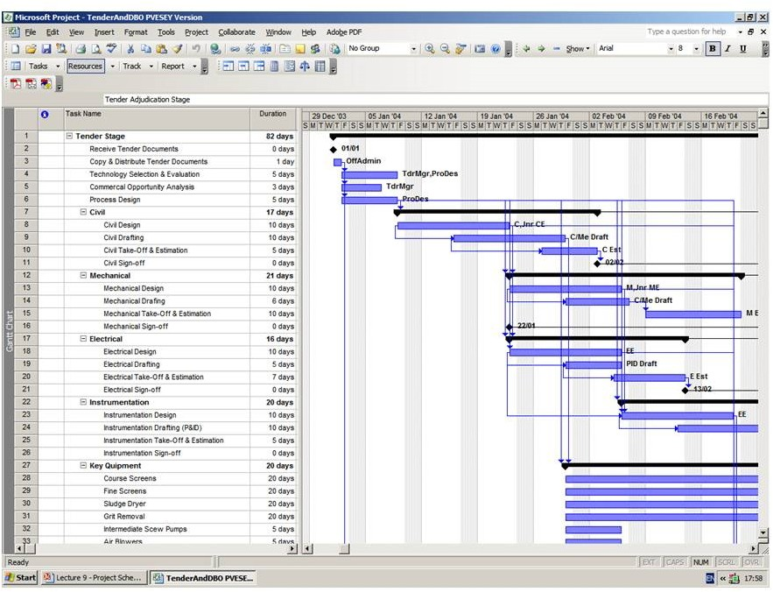
Project Management
Project Scheduling Basics

Slide 13

Project Management
Project Scheduling Basics

Slide 14
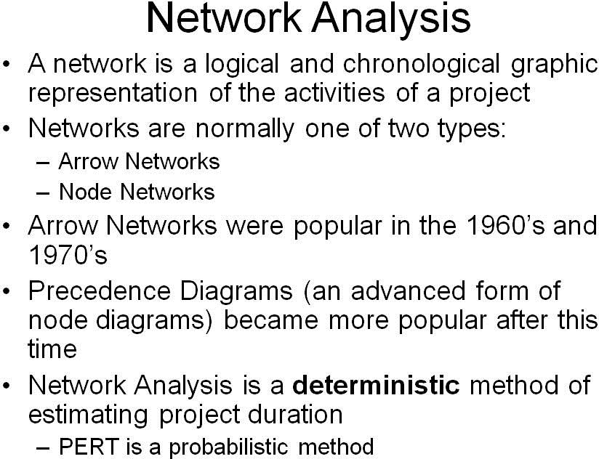
Project Management
Project Scheduling Basics

Slide 15
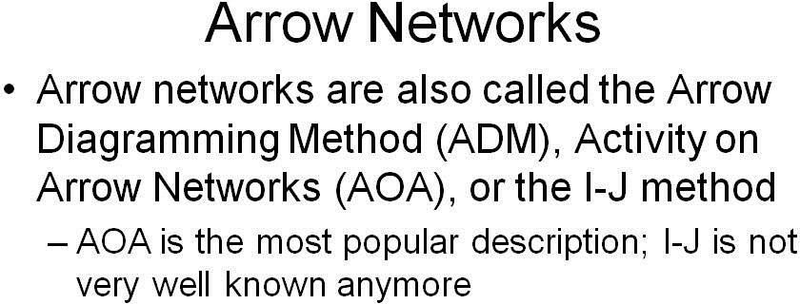
Project Management
Project Scheduling Basics

Slide 16
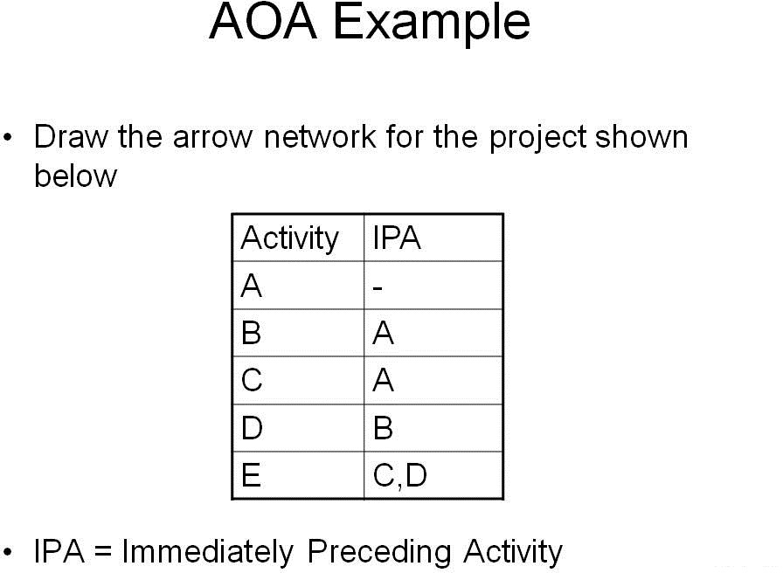
Project Management
Project Scheduling Basics

Slide 17
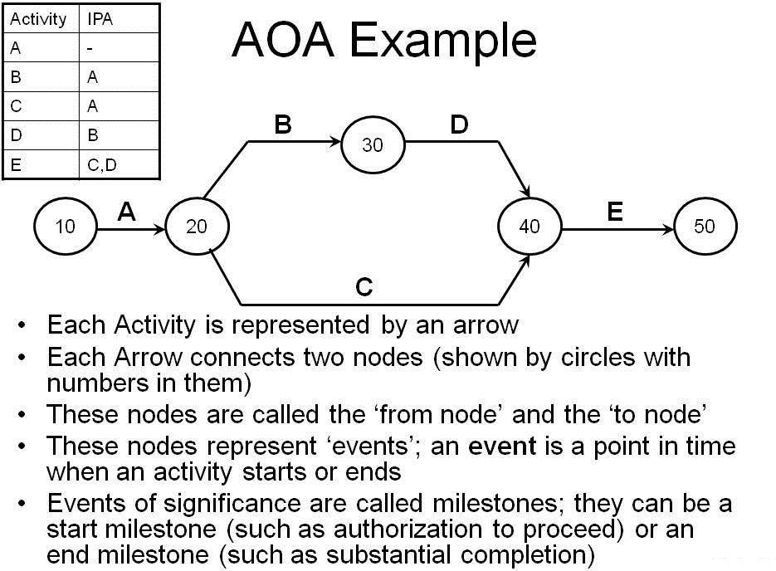
Project Management
Project Scheduling Basics

Slide 18
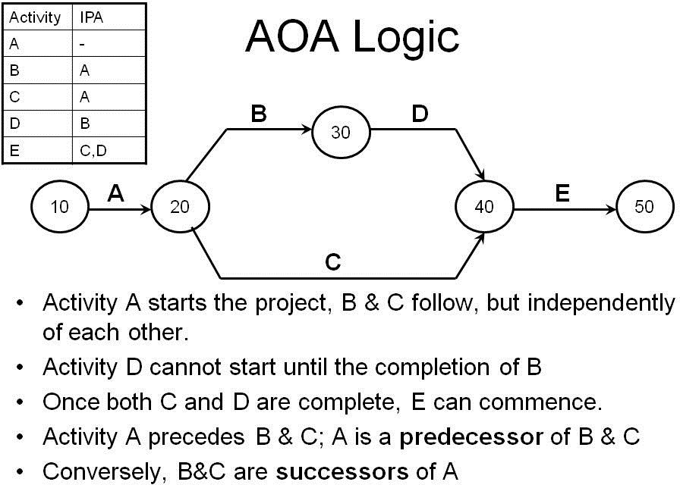
Project Management
Project Scheduling Basics

Slide 19
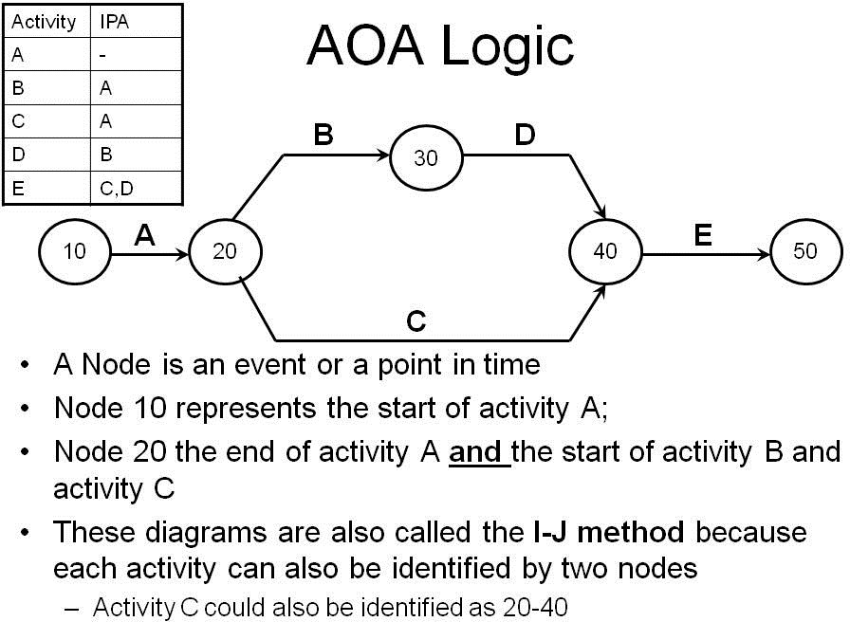
Project Management
Project Scheduling Basics

Slide 20
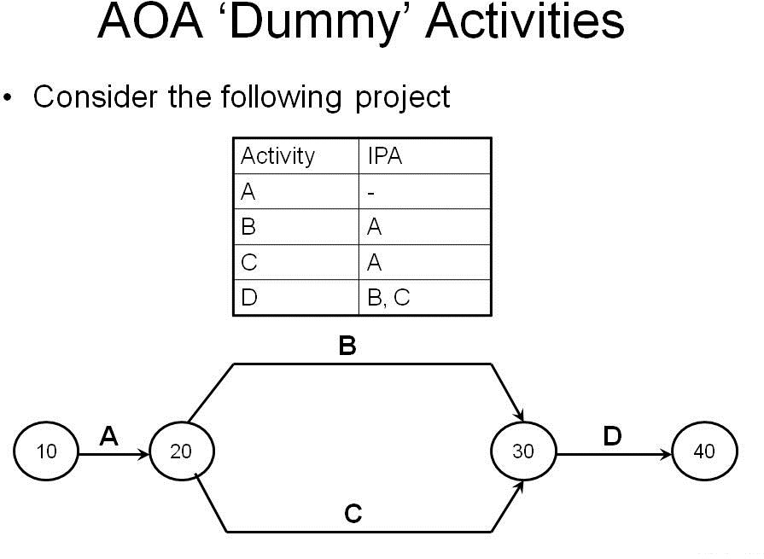
Project Management
Project Scheduling Basics

Slide 21
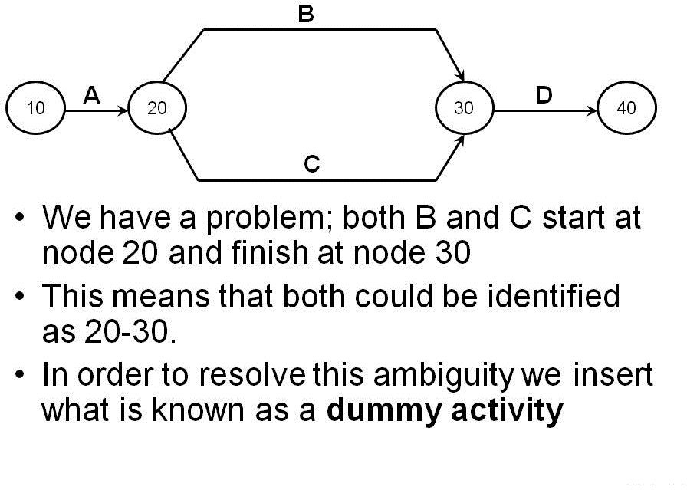
Project Management
Project Scheduling Basics

Slide 22
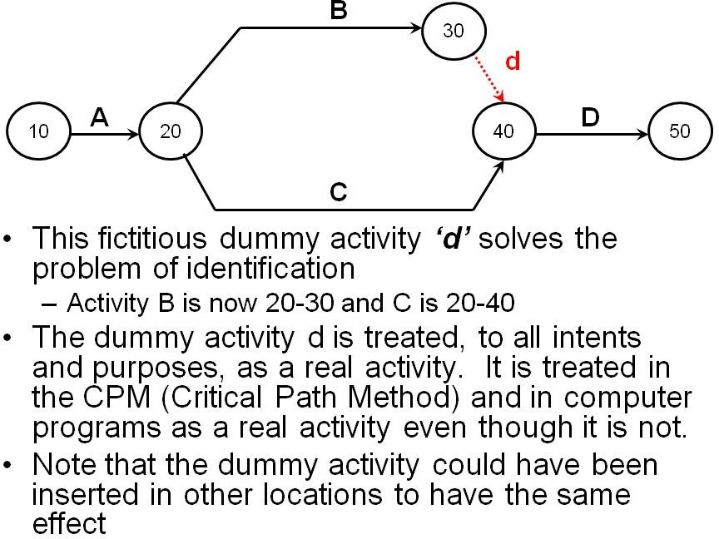
Project Management
Project Scheduling Basics

Slide 23
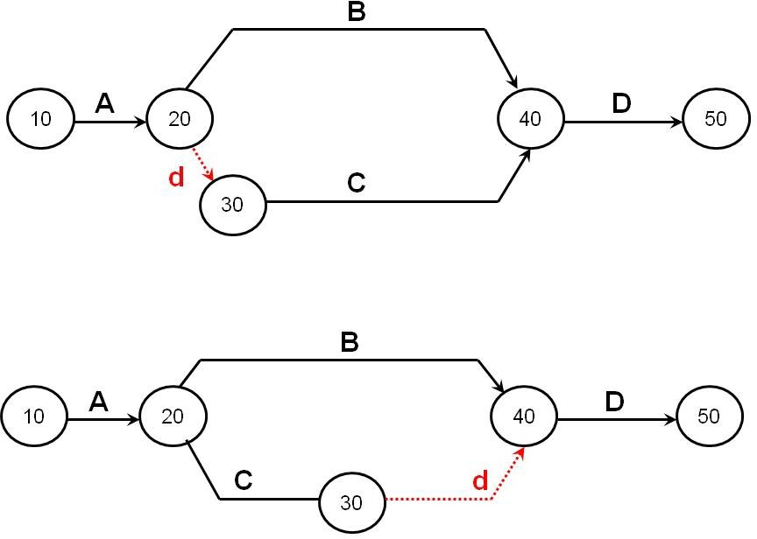
Project Management
Project Scheduling Basics

Slide 24
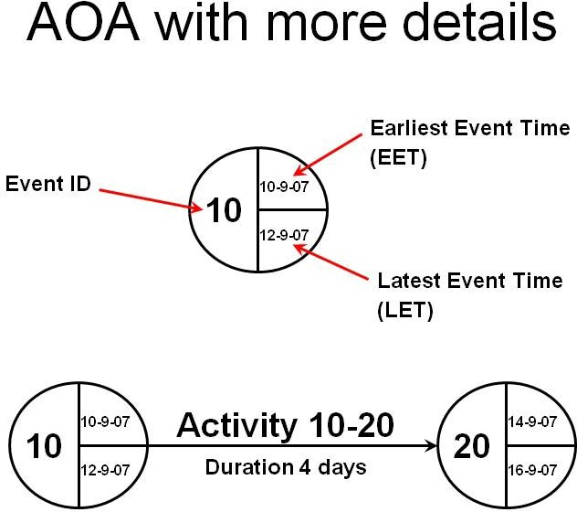
Project Management
Project Scheduling Basics

Slide 25
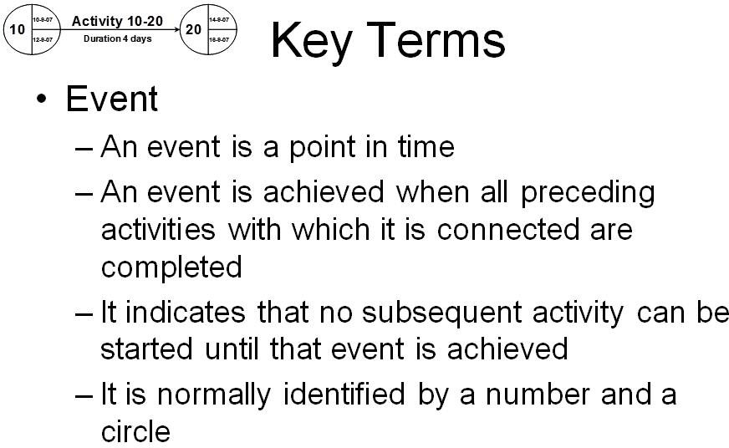
Project Management
Project Scheduling Basics

Slide 26
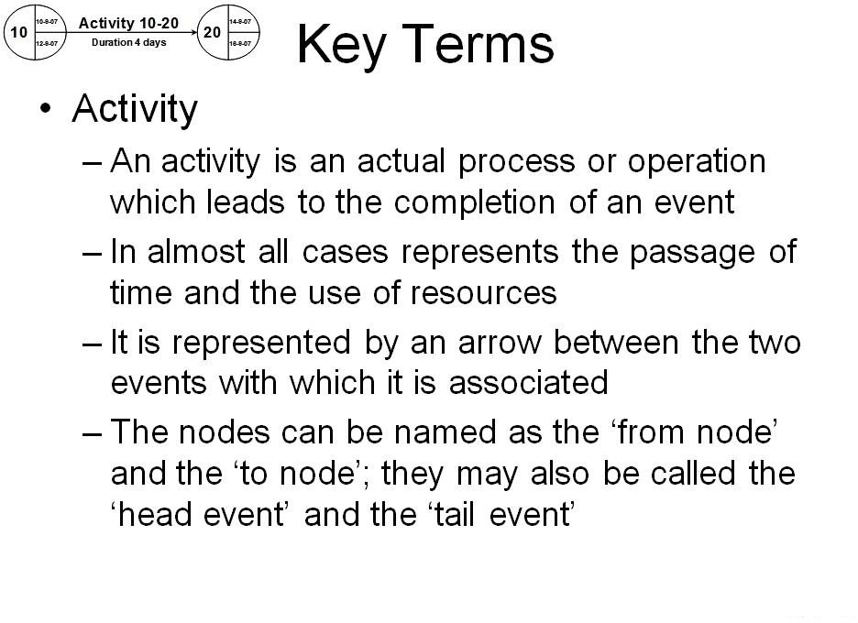
Project Management
Project Scheduling Basics

Slide 27
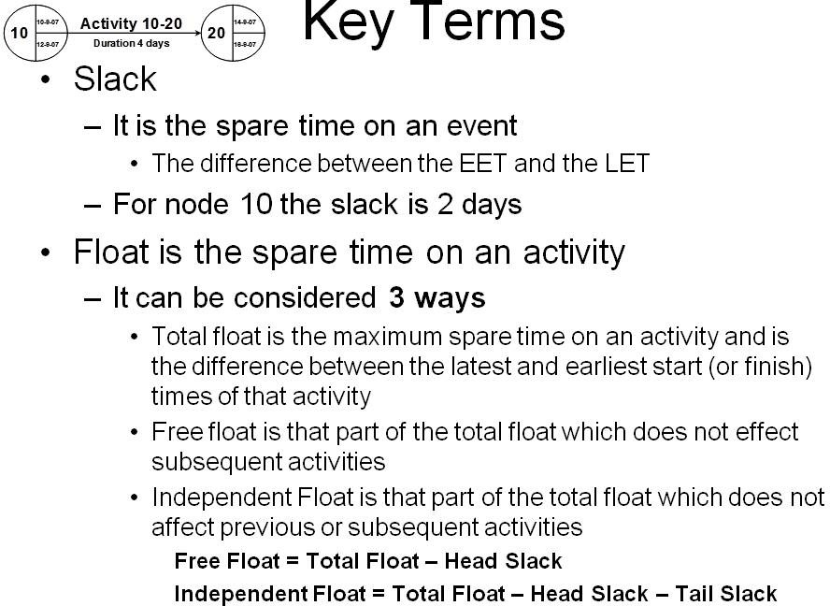
Project Management
Project Scheduling Basics

Slide 28
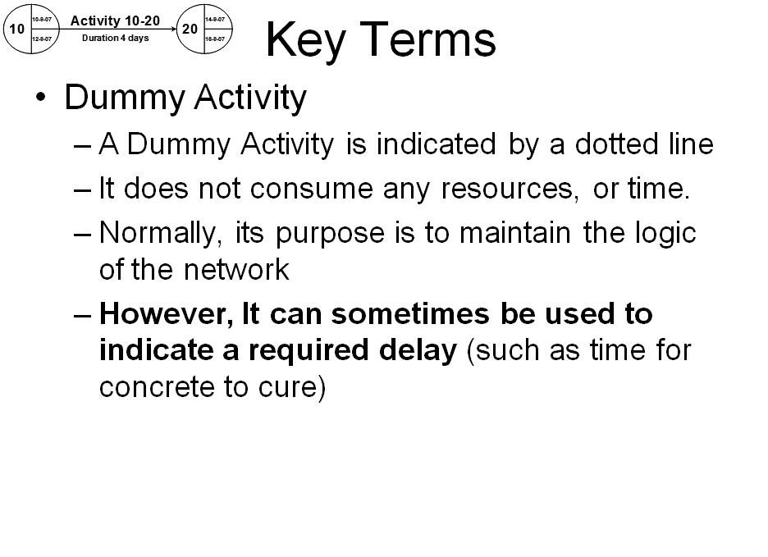
Project Management
Project Scheduling Basics

Slide 29
Project Management
Activity on Node
Additional Resources
Support Material Powerpoint Download Powerpoint View Online

Slide 30
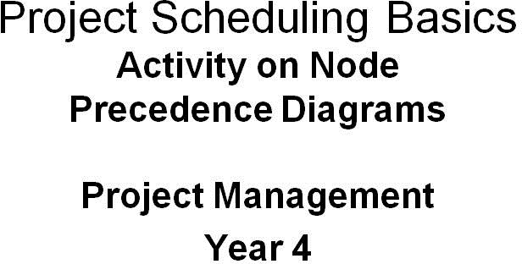
Project Management
Activity on Node

Slide 31
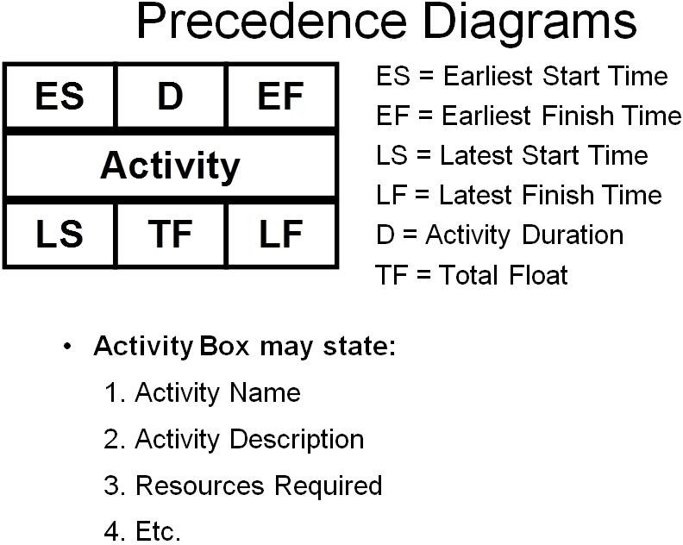
Project Management
Activity on Node

Slide 32
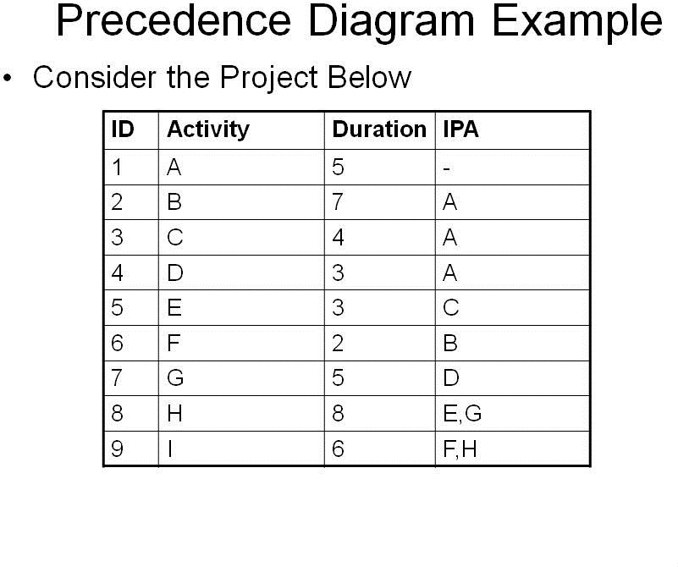
Project Management
Activity on Node

Slide 33
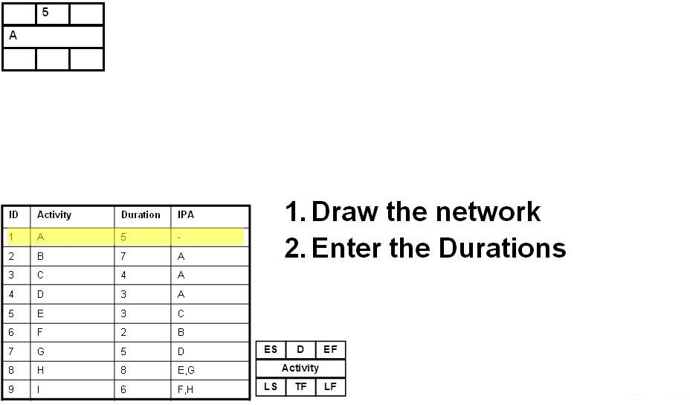
Project Management
Activity on Node

Slide 34
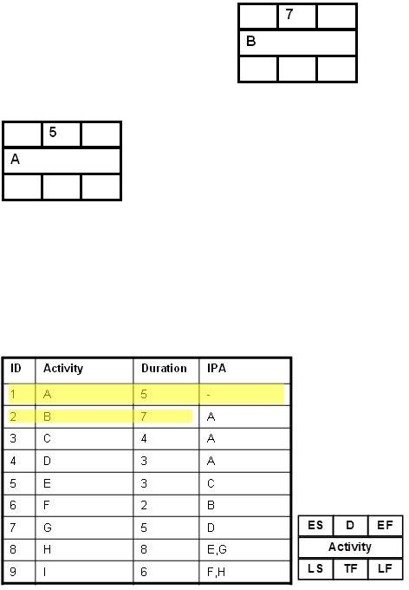
Project Management
Activity on Node

Slide 35
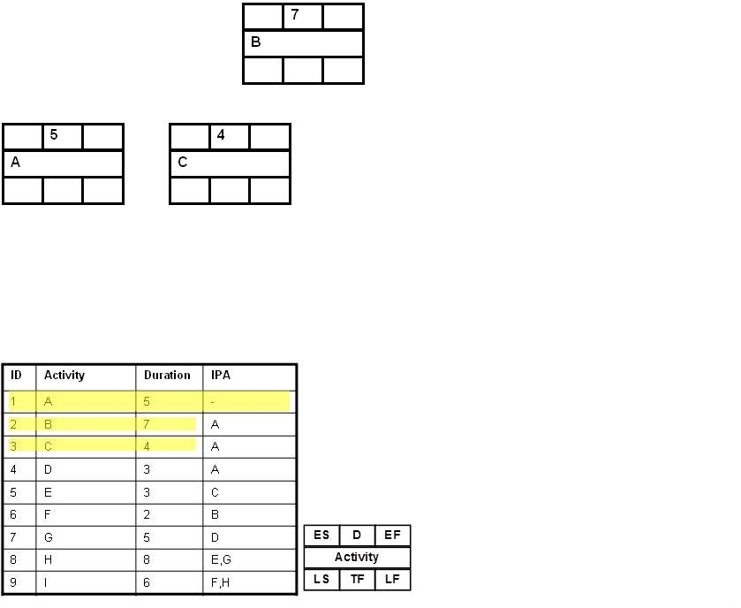
Project Management
Activity on Node

Slide 36
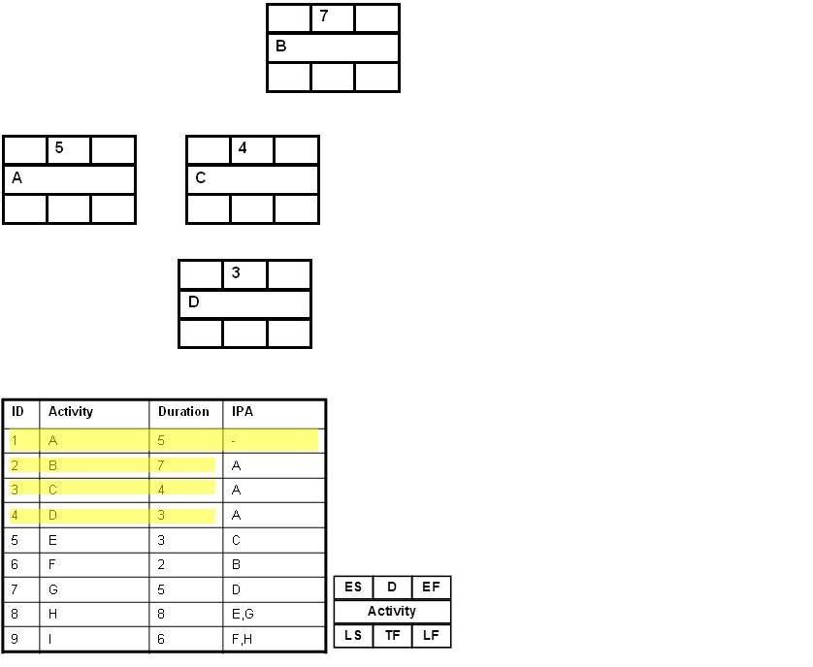
Project Management
Activity on Node

Slide 37
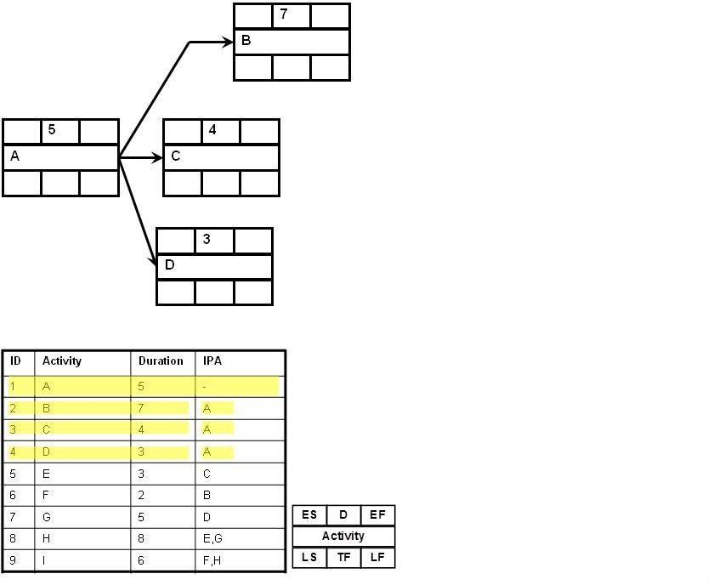
Project Management
Activity on Node

Slide 38
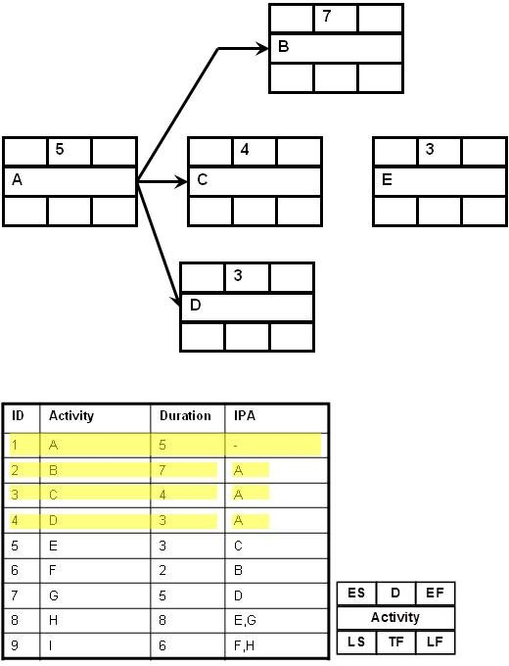
Project Management
Activity on Node

Slide 39
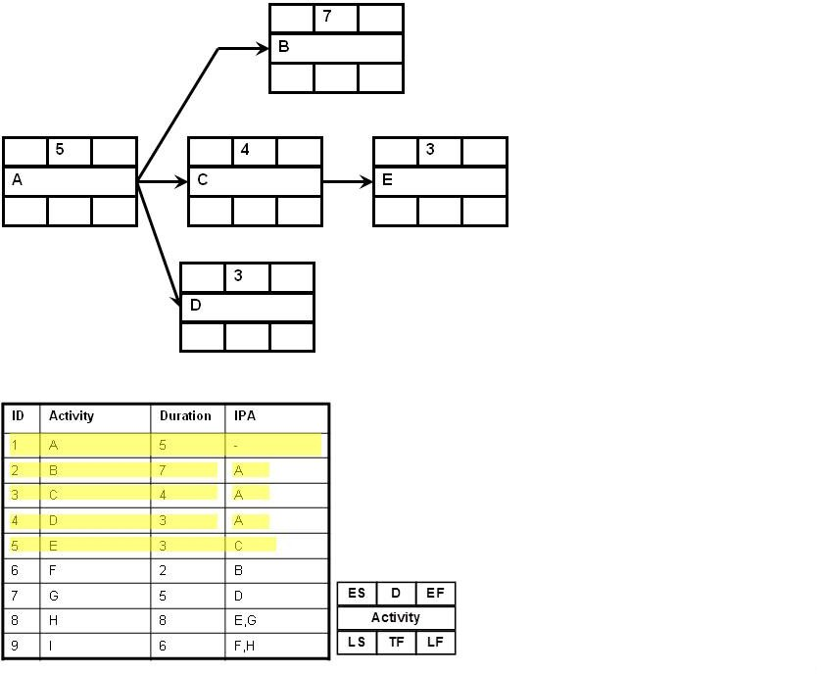
Project Management
Activity on Node

Slide 40
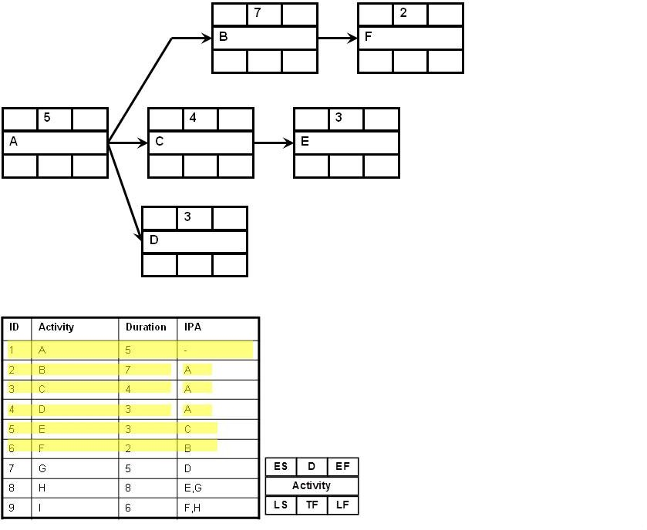
Project Management
Activity on Node

Slide 41
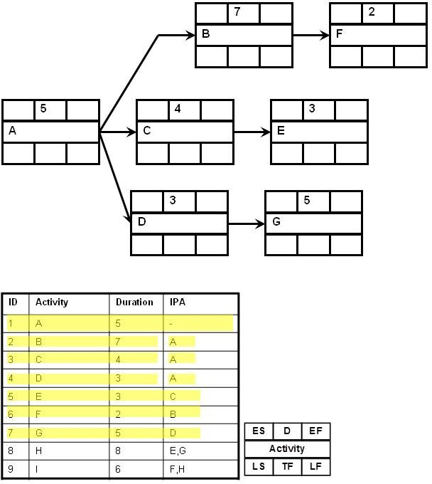
Project Management
Activity on Node

Slide 42
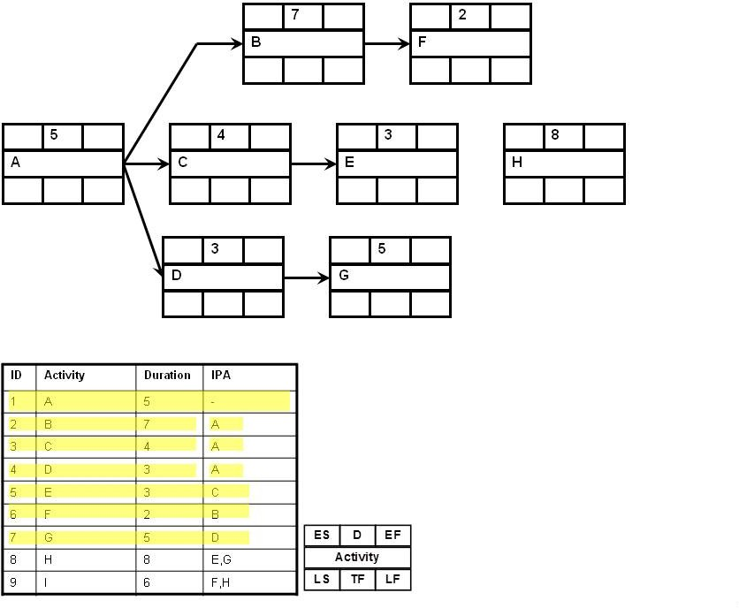
Project Management
Activity on Node

Slide 43
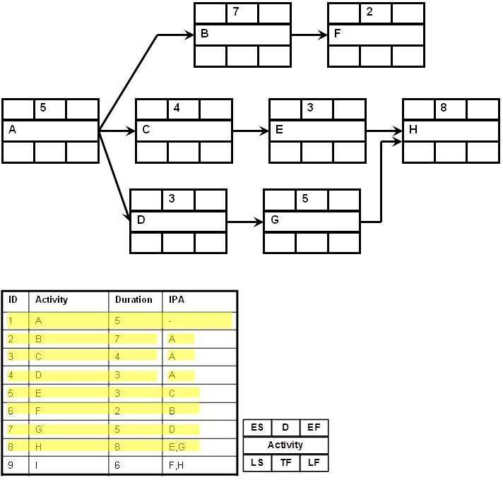
Project Management
Activity on Node

Slide 44
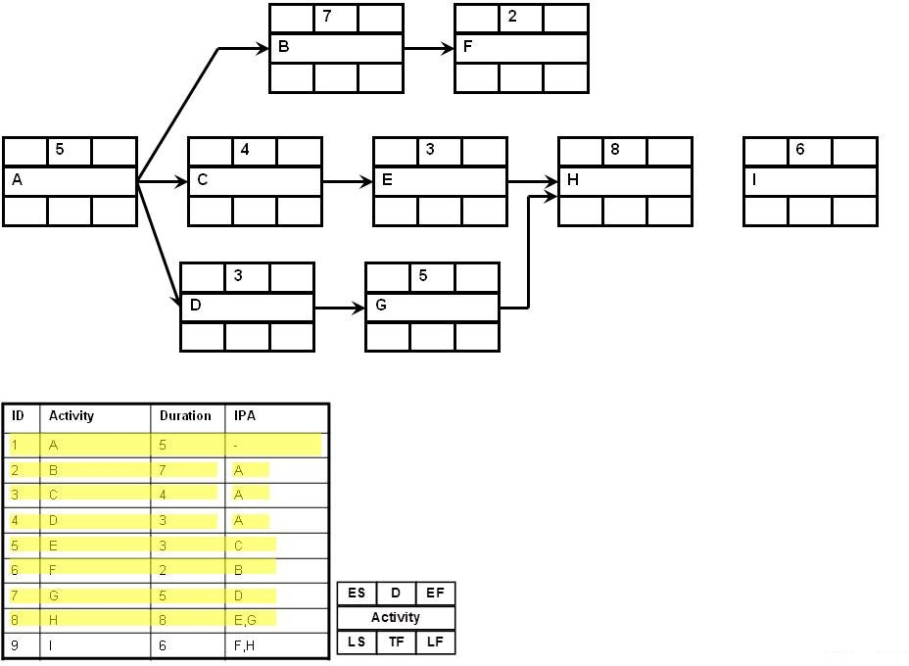
Project Management
Activity on Node

Slide 45
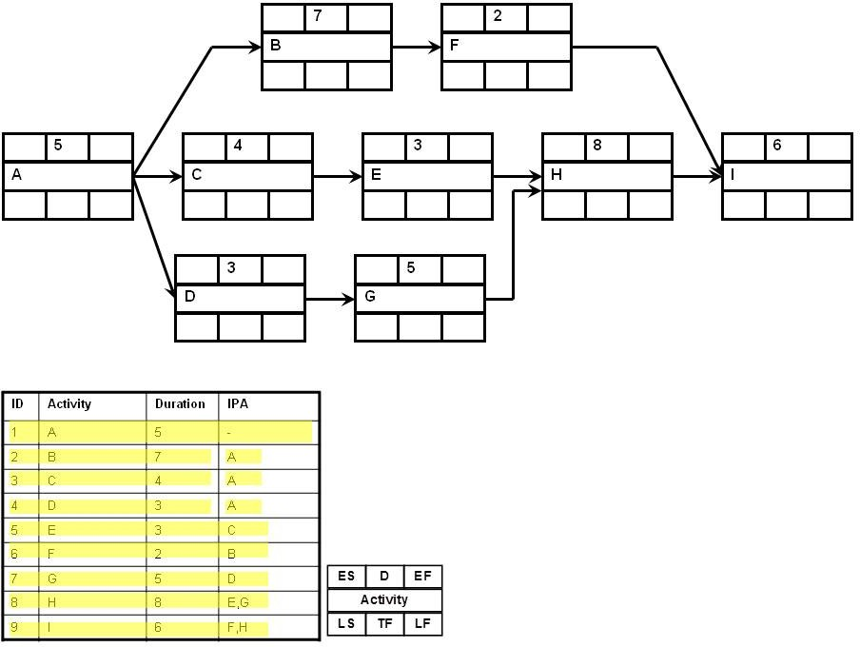
Project Management
Activity on Node

Slide 46
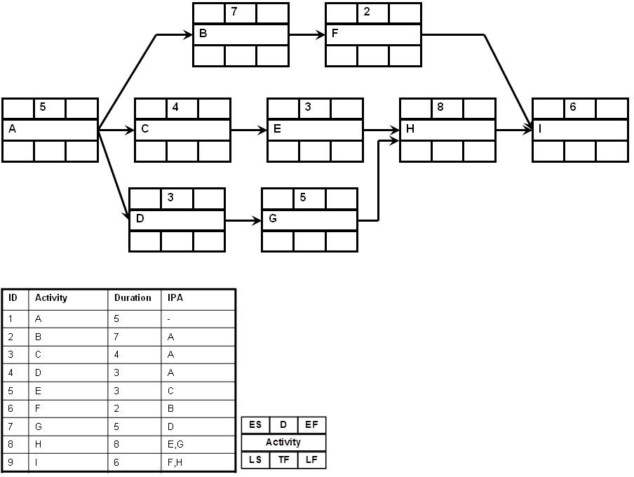
Project Management
Activity on Node

Slide 47
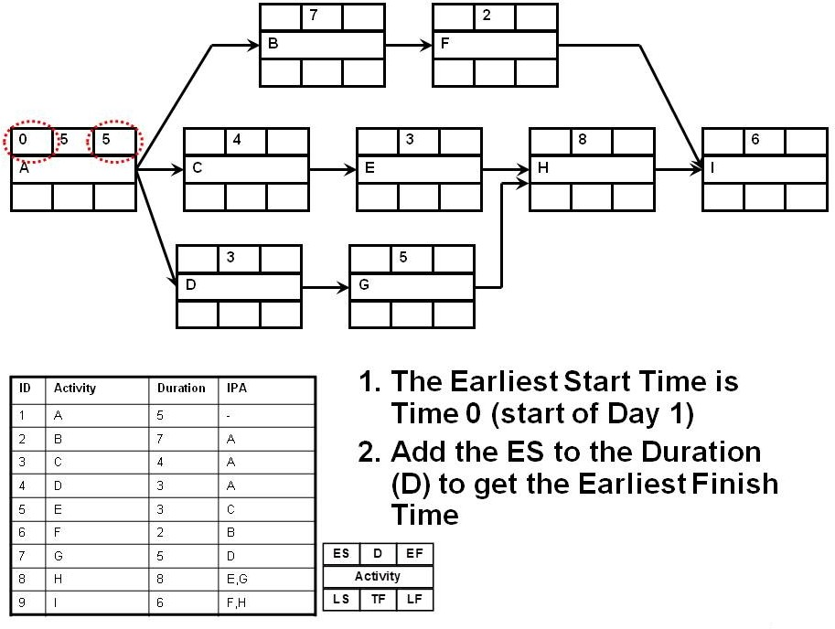
Project Management
Activity on Node

Slide 48
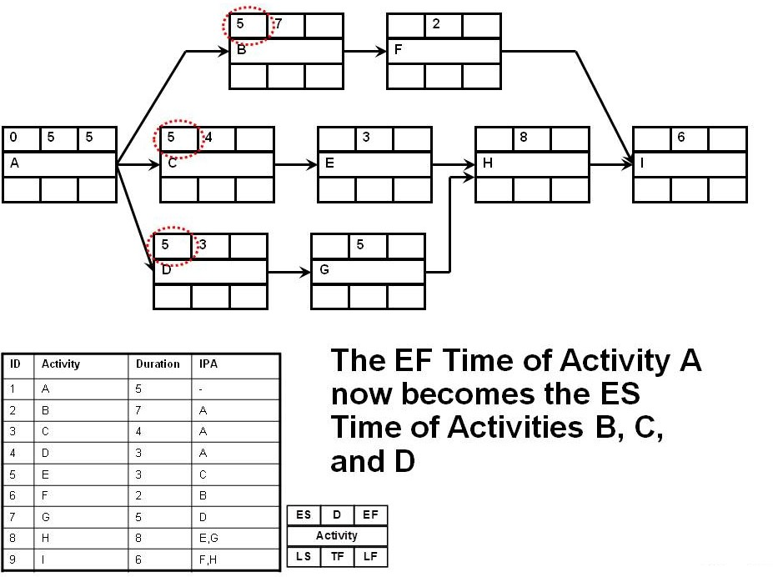
Project Management
Activity on Node

Slide 49
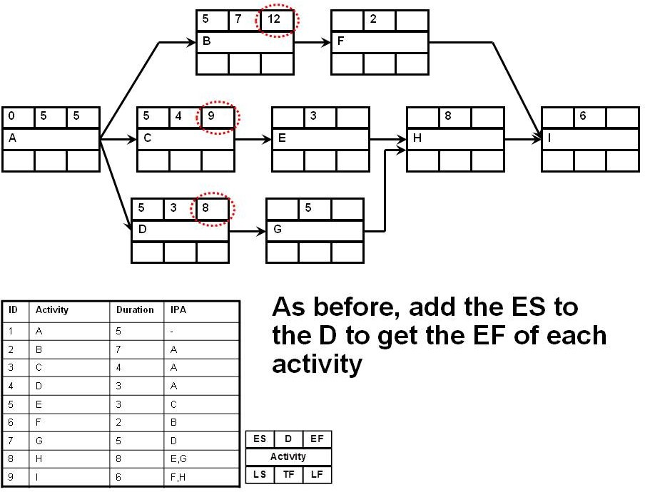
Project Management
Activity on Node

Slide 50
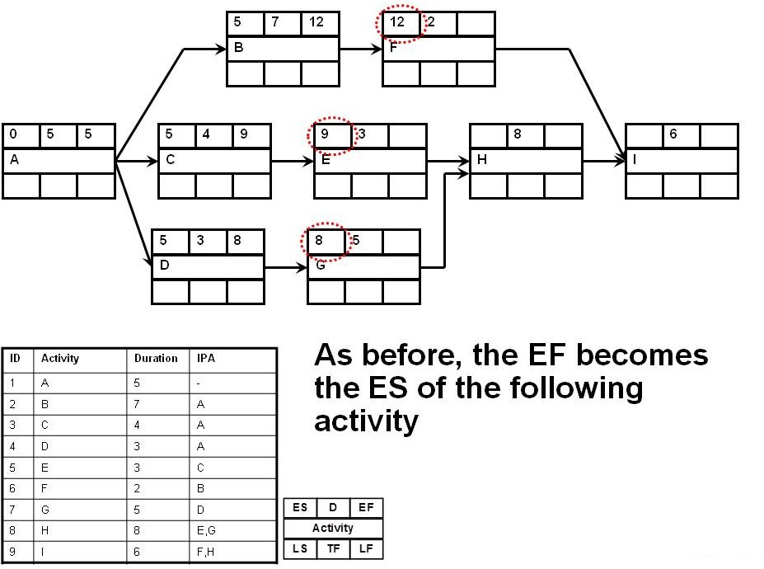
Project Management
Activity on Node

Slide 51
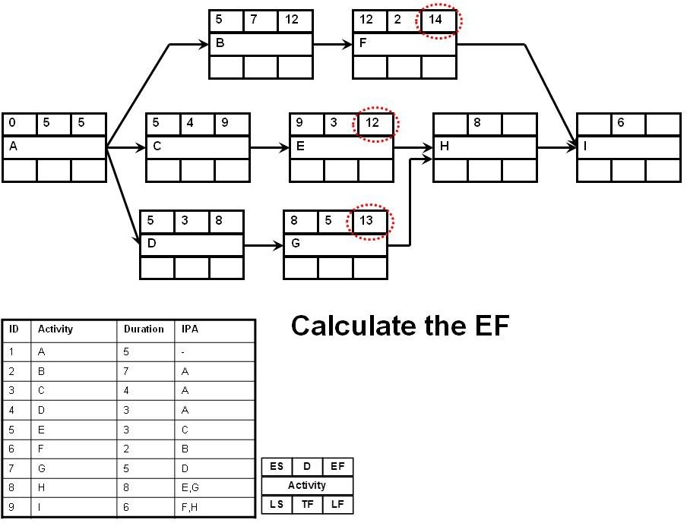
Project Management
Activity on Node

Slide 52
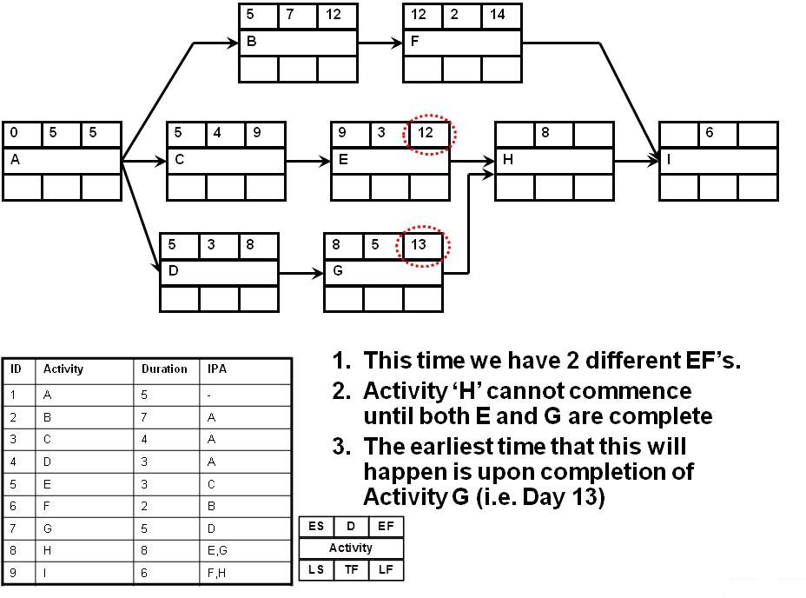
Project Management
Activity on Node

Slide 53
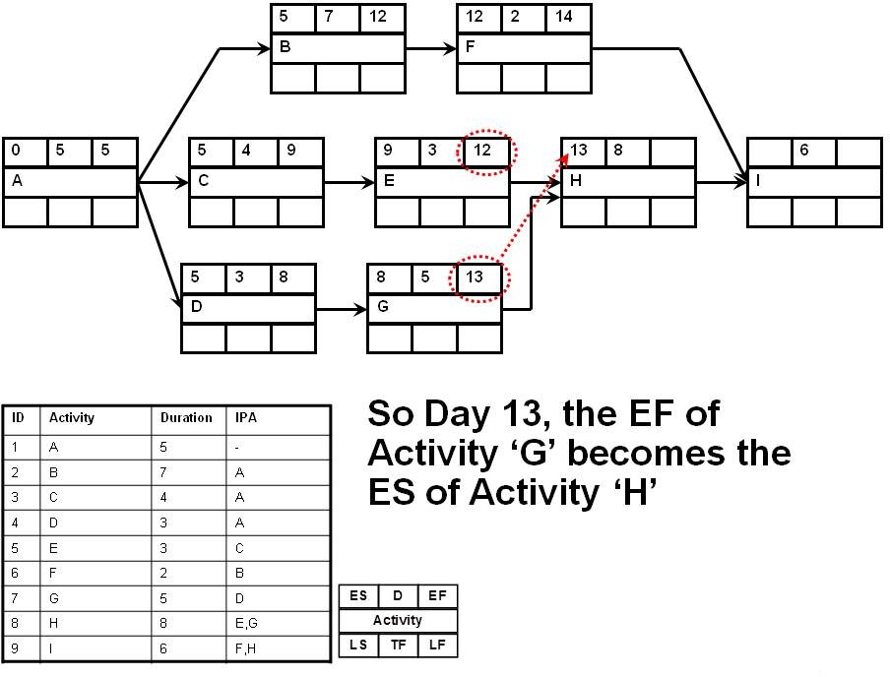
Project Management
Activity on Node

Slide 54

Project Management
Activity on Node

Slide 55

Project Management
Activity on Node

Slide 56

Project Management
Activity on Node

Slide 57

Project Management
Activity on Node

Slide 58

Project Management
Activity on Node

Slide 59

Project Management
Activity on Node

Slide 60

Project Management
Activity on Node

Slide 61

Project Management
Activity on Node

Slide 62

Project Management
Activity on Node

Slide 63

Project Management
Activity on Node

Slide 64

Project Management
Activity on Node

Slide 65

Project Management
Activity on Node

Slide 66

Project Management
Activity on Node

Slide 67

Project Management
Activity on Node

Slide 68

Project Management
Activity on Node

Slide 69

Project Management
Activity on Node

Slide 70

Project Management
Activity on Node

Slide 71

Project Management
Activity on Node

Slide 72

Project Management
Activity on Node

Slide 73

Project Management
Activity on Node

Slide 74

Project Management
Activity on Node

Slide 75

Project Management
Activity on Node

Slide 76

Project Management
Activity on Node

Slide 77

Project Management
Activity on Node

Slide 78

Project Management
Activity on Node

Slide 79

Project Management
Activity on Node

Slide 80

Project Management
Activity on Node

Slide 81

Project Management
Activity on Node

Slide 82

Project Management
Activity on Node

Slide 83

Project Management
Activity on Node

Slide 84

Project Management
Activity on Node

Slide 85

Project Management
Activity on Node

Slide 86

Project Management
Activity on Node

Slide 87

Project Management
Activity on Node

Slide 88

Project Management
Activity on Node

Slide 89

Project Management
Activity on Node

Slide 90

Project Management
Activity on Node

Slide 91

Project Management
Activity on Node

Slide 92

Project Management
Activity on Node

Slide 93

Project Management
Activity on Node

Slide 94

Project Management
Activity on Node

Slide 95
Project Management
PMBOK Processes
Project Time Management
Define Activities Sequence Activities
Estimate Activity Resources Estimate Activity Durations Develop Schedule
Control Schedule
We have already covered some of the material for Time Management, namely:
Gantt Charts, Network Diagrams, Line of Balance, Time Chainage, PERT

Slide 96

Project Management
PMBOK Processes
Define Activities
Part of the Planning Process Group

Slide 97
Project Management
PMBOK Processes
Define Activities
Generally, Activity definition involves identifying and documenting schedule activities at the lowest level of the WBS i.e. work packages
There is an overlap between WBS, WBS Dictionary and Activity Definition
The main difference is that the WBS decomposes the project in terms of deliverables, and ‘Activity Definition’ decomposes the project in terms of schedule activities Ideally, ‘WBS’, ‘WBS Dictionary’, and ‘Activity Definition’ should be carried out in parallel.

Slide 98
Project Management
PMBOK Processes
Tools and Techniques Rolling Wave Planning
AKA Moving Window planning
Rolling Wave planning is a form of progressive elaboration, whereby work to be accomplished in the near future is planned in detail at low levels of the WBS
Elements further into the future are only planned to the upper levels in the WBS
Increases the risks associated with the project
For complex projects, it is often the only way to execute Two key points to consider:
How far out you can plan in detail will vary considerably from project to project
It works best when client and upper management understand how the technique works

Slide 99

Project Management
PMBOK Processes
If the client or senior managers are not aware of the effects of progressive elaboration, there can be serious effects.
Project budgets are normally set at the early stages of the project. Where PE is being used, a probability should be assigned to estimated costs to ensure funding will be available.

Slide 100
Project Management
PMBOK Processes
Cost Estimate Accuracy
WBS |  | Estimate | Accuracy
Level | Description | Low Risk Projects | High Risk Projects
1 | Program | ±35% ±20% ±10% ±5% ±2% | ±75-100% ±50-60% ±20-30% ±10-15% ±5-10%
2 | Project
3 | Task
4 | Subtask
5 | Work Package
Table: Kerzner (2009), P569
This partially explains why tender prices can vary as much as 30% between highest and lowest

Slide 101
Project Management
PMBOK Processes
Define Activities
Outputs
Activity List
Comprehensive list of all schedule activities
Activity Attributes
Activity identifier Predecessors Successors Logic Relationships
Leads Lags
Resource Requirements
Milestone List
Mandatory or otherwise

Slide 102

Project Management
PMBOK Processes
Sequence Activities
Part of the Planning Process Group

Slide 103

Project Management
PMBOK Processes
Sequence Activities
Activity Sequencing Involves identifying and documenting the logical relationship amongst schedule activities
The logical relationships between schedule activities must be considered when determining project schedules
Tools and techniques for this have already been covered :

Slide 104
Project Management
PMBOK Processes
Tools and Techniques
Precedence Diagrams
Already covered
Dependency Determination
Mandatory or Hard Logic, Inherent in the nature of the work being done
Discretionary, Preferred Logic, Soft Logic e.g. Landscaping
External: Usually driven by dependencies between project activities and non-project activities such as Planning Permission, IPC Licence, etc.

Slide 105
Project Management
PMBOK Processes
Tools and Techniques
Leads and Lags
Concrete set time typically creates a Lag Refer to book
Schedule Network Templates
Entire project or portions of the project
Allows transfer of information from project to project (Knowledge Management)
Lessens the likelihood of errors of omission

Slide 106

Project Management
PMBOK Processes
Estimate Activity Resources
Part of the Planning Process Group

Slide 107
Project Management
PMBOK Processes
Estimate Activity Resources
Inputs
Refer to Book..
Resource calendars: Concerned with resource availability
People, Equipment, Materials
People: are appropriate skill sets available? Equipment: Own or Hire
Materials: Availability, Storage, lead times, etc.

Slide 108

Project Management
PMBOK Processes
Tools and Techniques
Alternatives Analysis
Machine Types, Size, etc. Make or Buy?
Published Estimating Data
e.g. Spons Guides - Contains time and money data
Bottom Up Estimating
Most difficult and time consuming, however if done properly is highly accurate
Project Management Software
MS Project Resource Sheets, etc.

Slide 109

Project Management
PMBOK Processes
Bottom-Up Estimating Example
Installation of a water meter box
Time Locate existing stop-tap Setup equipment Excavate Cut and Remake Connections Fill and Compact Concrete Collar | 5 min 15 min 10 min 10 min 10 min 10 min
Total Time | 60 min
Cost Van, Tools & equip Labour | e 200 p/h e 120 p/h
Total Cost | e 320 p/h
This example works out direct cost and time only

Slide 110

Project Management
PMBOK Processes
Estimate Activity Durations
Part of the Planning Process Group
110 / 130

Slide 111
Project Management
PMBOK Processes
Estimate Activity Durations
Activity Duration Estimating involves:
Estimating the amount of work required to complete an activity
The level and type of resources that must be applied to complete an activity
By using the above information, an estimate of the time taken to complete the task can be derived.
All data and assumptions that support the duration estimate are documented for each activity

Slide 112
Project Management
PMBOK Processes
Estimate Activity Durations
Work, Time, Resource relationship
_{Time Required =} Work Required
Resources Applied
Note: this is a pseudo-mathematical relationship.
The actual mathematical relationship will depend on how the 3 elements (work, time, resource) are defined.
The mathematical relationship is better described below:
t = f (w, r)

Slide 113
Project Management
PMBOK Processes
Tools & Techniques
Expert Judgment
Refer to Book
Very common, but not accurate enough; should be combined with one or more other methods to improve accuracy
Analogous Estimating
Means using the actual duration of a previous similar activity as the basis for estimating the duration of a future schedule activity
Very common method.

Slide 114
Project Management
PMBOK Processes
Tools & Techniques
Parametric Estimating
Using the work, time, resource relationship
t = f (w, r)
Parametric Estimating is a process by which the duration of an activity can be quantitatively determined by multiplying the quantity of work to be performed by the productivity rate
Can be highly accurate. However, beware of inaccurate base data, or improperly used base data.

Slide 115

Project Management
PMBOK Processes
SPON’s Architects & Builders

Slide 116

Project Management
PMBOK Processes
SPON’s Mech & Elec

Slide 117
Project Management
PMBOK Processes
Three-Point Estimates
The accuracy of a duration estimate can be improved by considering the amount of risk in the original estimate. Three types of estimate are produced:
Most Likely Optimistic Pessimistic
The average of these three estimates is taken Average Duration
t + t + t
o m p
3
t =
e
Weighted Average Duration (as per PERT)
t + 4t + t
o m p
6
t =
e

Slide 118
Project Management
PMBOK Processes
Reserve Analysis
Reserve analysis means adding time to a previously determined (or estimated) activity duration to account for:
Potential Data inaccuracies (analogous, parametric etc.) Schedule risks (resource availability etc.)
Contingencies can be based on %age of estimated activities, fixed durations, etc.
Contingency reserves can be utilised, reduced or eliminated as the project progresses and more information becomes available All aspects of contingency reserves should be documented

Slide 119
Project Management
PMBOK Processes
Activity Duration Estimating
Outputs
Activity Durations Estimates: quantitative assessments of the work periods (time) that will be required to complete schedule activities
2 weeks ± 2 days
85% probability of 12 days Project Document Updates
Refer to book and previous lectures

Slide 120

Project Management
PMBOK Processes
Develop Schedule
Part of the Planning Process Group
120 / 130

Slide 121
Project Management
PMBOK Processes
Develop Schedule
Schedule Development is an iterative process to determine the planned start and planned completion dates for project activities Duration Estimates and Resource Estimates may need to be revised in order to develop an accurate schedule against which project progress can be tracked
The initial Project Schedule is known as the ‘Baseline Schedule’.
Schedule Development continues throughout the course of the project.
Risk Events may occur, or may not occur Resource Availabilities may change Scope may change
Etc.

Slide 122
Project Management
PMBOK Processes
Tools & Techniques
Network Analysis, CPM, Critical Chain Already covered in lectures
Refer to Book for further details Schedule Compression
Crashing Fast Tracking
What-if Scenario Analysis Resource Leveling

Slide 123
Project Management
PMBOK Processes
Schedule Compression
Schedule Compression shortens the project schedule without changing the project scope.
Crashing: shortening activity durations, in order to shorten the overall project duration
Fast-Tracking: commencing phases (or activities) before their logical predecessor is completed.

Slide 124
Project Management
PMBOK Processes
Crashing
Shortening Activity durations in order to shorten overall project duration.
Usually involves shortening durations on the critical path. Shortening durations on the Critical Path may change the Critical Path
Crashing normally involves increased costs
Crashing involves increasing the resources (labour and/or equipment) assigned to an activity.
Remember:
_{Time Required =} Work Required
Resources Applied
You cannot change the work; the scope must remain unchanged

Slide 125
Project Management
PMBOK Processes
Crashing
Never crash a project at planning stage
At planning stage you should be looking at building in schedule contingency.
If you are crashing at planning stage then you have underestimated resources or resource availability (need to re-plan, not crash)
Better to look at:
Sequence of Activities Internal v. External Resources
Modification of Scope (requires stakeholder approval)

Slide 126
Project Management
PMBOK Processes
Crashing
A correctly planned and executed project should not require crashing
Crashing a project should be looked upon as the last resort for bringing a project back on schedule
Not all activities can be crashed
It takes one woman nine months to have a baby. It cannot be done in one month by impregnating nine women.
Crashing an activity will always be subject to some form of constraint

Slide 127
Project Management
PMBOK Processes
Crashing
Trade-offs
Increased Cost Increased Risk
Not just Schedule Risk; Health & Safety may be compromised, H&S should never be compromised.
Typically increased management effort is required
Crashing one project may have a detrimental effect on other projects (or operations) being undertaken by the organization

Slide 128
Project Management
PMBOK Processes
Additional Resources
Support Material Excel File Download View File Online

Slide 129
Project Management
PMBOK Processes
More on Crashing
If you must crash a project, consider the following:
If you are crashing to bring a project back on schedule: Don’t crash too early; If you need to crash early activities then chances are that the schedule is wrong in the first
place, or there has been a delay. Better to get an EOT.
You cant crash what you have already done, or what is already in progress. Crashing tasks while in progress tends to lead to confusion. Better to look ahead and plan the crashing of an activity.
Crashing a construction project can put too many people in
the same physical location, thus impeding progress and reducing productivity

Slide 130
Project Management
PMBOK Processes
More on Crashing
If you must crash a project, consider the following: Financial Aspects
If LD clause exists, then compare crash costs against LDs. It may be cheaper to pay the LDs
Make sure you understand the effects of crashing on the financial aspects of the project. i.e. if 25% is added to the project cost, will it still be financially viable?
130 / 130

